Slide 1
Introduction to Programming
Session 04
Loop Statements

Slide 2
Objectives
For
While
Do-while
Break, continue

Slide 3
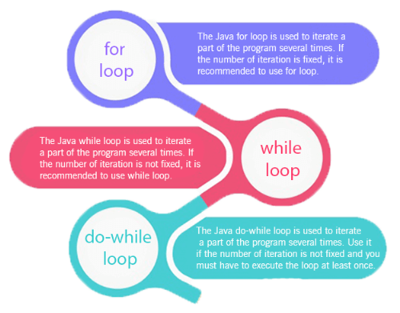
Loops in Java
In programming languages, loops are used to execute a set of instructions/functions repeatedly when some conditions become true.
There are three types
of loops in java.
  for loop
  while loop
  do-while loop

Slide 4
Java For Loop
The Java for loop is used to iterate a part of the program several times. If the number of iteration is fixed, it is recommended to use for loop.
There are three types of for loops in java.
  Simple For Loop
  For-each or Enhanced For Loop
  Labeled For Loop

Slide 5
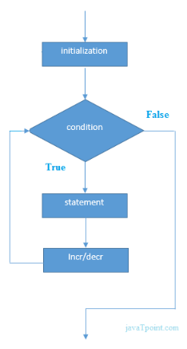
Java For Loop
A simple for loop consists of four parts:
  Initialization: It is the initial condition which is executed once when the loop starts. Here, we can initialize the variable, or we can use an already initialized variable. It is an optional condition.
  Condition: It is the second condition which is executed each time to test the condition of the loop. It continues execution until the condition is false. It must return boolean value either true or false. It is an optional condition.
  Statement: The statement of the loop is executed each time until the second condition is false.
  Increment/Decrement: It increments or decrements the variable value. It is an optional condition.
Syntax:
  for(initialization;condition;incr/decr){
  //statement or code to be executed
  }

Slide 6
Java For Loop
public class ForExample {
  public static void main(String[] args) {
  for(int i=1;i<=10;i++){
  System.out.println(i);
  }
  }
}
Output:
1
2
3
4
5
6
7
8
9
10

Slide 7
Java Nested For Loop
If we have a for loop inside the another loop, it is known as nested for loop. The inner loop executes completely whenever outer loop executes.
Example:
  public class NestedForExample {
    public static void main(String[] args) {
      //loop of i
      for(int i=1;i<=2;i++){
      //loop of j
        for(int j=1;j<=2;j++){
        System.out.println(i+" "+j);
        }//end of i
      }//end of j
    }
  }
Output:
1 1
1 2
2 1
2 2

Slide 8
Java for-each Loop
The for-each loop is used to traverse array or collection in java. It is easier to use than simple for loop because we don't need to increment value and use subscript notation.
It works on elements basis not index. It returns element one by one in the defined variable.
Syntax:
  for(Type var:array){
  //code to be executed
  }

Slide 9
Java for-each Loop
public class ForEachExample {
  public static void main(String[] args) {
  //Declaring an array
  int arr[]={12,23,44,56,78};
  //Printing array using for-each loop
  for(int i:arr){
  System.out.println(i);
  }
  }
}
Output:
12
23
44
56
78

Slide 10
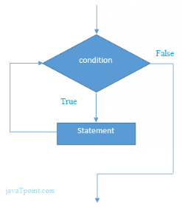
Java While Loop
The Java while loop is used to iterate a part of the program several times. If the number of iteration is not fixed, it is recommended to use while loop.
Syntax:
  while(condition){
  //code to be executed
  }

Slide 11
Java While Loop
public class WhileExample {
  public static void main(String[] args) {
  int i=1;
  while(i<=10){
  System.out.println(i);
  i++;
  }
  }
}
Output:
1
2
3
4
5
6
7
8
9
10

Slide 12
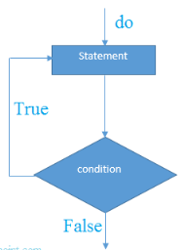
Java do-while Loop
The Java do-while loop is used to iterate a part of the program several times. If the number of iteration is not fixed and you must have to execute the loop at least once, it is recommended to use do-while loop.
The Java do-while loop is executed at least once because condition is checked after loop body.
Syntax:
  do{
  //code to be executed
  }while(condition);

Slide 13
Java do-while Loop
public class DoWhileExample {
  public static void main(String[] args) {
  int i=1;
  do{
  System.out.println(i);
  i++;
  }while(i<=10);
  }
}
Output:
1
2
3
4
5
6
7
8
9
10

Slide 14
Java Break
You have already seen the break statement used in an earlier chapter of this tutorial. It was used to "jump out" of a switch statement.
The break statement can also be used to jump out of a loop.
public class BreakExample1 {
  public static void main(String[] args) {
  for (int i = 1; i < 10; i++)
  {
  if (i == 4) { break; }
  System.out.println(i);
  }
  }
}
Output:
1
2
3

Slide 15
Java Break
public class BreakExample2 {
  public static void main(String[] args) {
  int i = 1;
  while (i < 10)
  {
  System.out.println(i);
  i++;
  if (i == 4)
  {
  break;
  }
  }
  }
}
Output:
1
2
3

Slide 16
Java Continue
The continue statement breaks one iteration (in the loop), if a specified condition occurs, and continues with the next iteration in the loop.
public class ContinueExample1 {
  public static void main(String[] args) {
  for (int i = 1; i < 10; i++)
  {
  if (i == 4) {continue; }
  System.out.println(i);
  }
  }
}
Output:
1
2
3
5
6
7
8
9
10

Slide 17
Java Continue
public class ContinueExample2{
  public static void main(String[] args) {
  int i = 1;
  while (i < 10)
  {
  if (i == 4)
  {
  i++;
  continue;
  }
  System.out.println(i);
  i++;
  }
  }
}
Output:
1
2
3
5
6
7
8
9
10

Slide 18
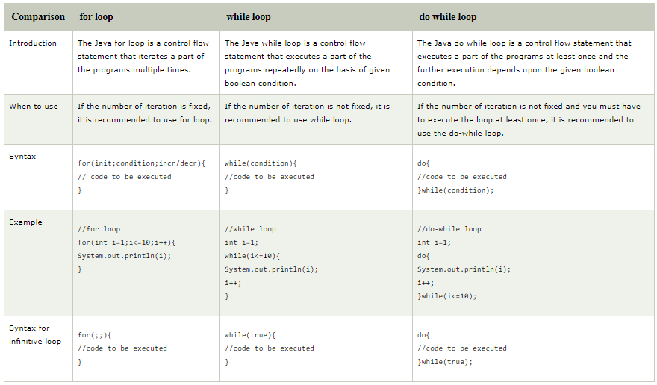
Java For Loop vs While Loop vs Do While Loop

Slide 19
References
https://www.learnjavaonline.org/en/Loops
https://www.javatpoint.com/java-for-loop
https://www.javatpoint.com/java-while-loop
https://www.javatpoint.com/java-do-while-loop
https://www.w3schools.com/java/java_for_loop.asp
https://www.geeksforgeeks.org/loops-in-java/
https://www.tutorialspoint.com/java/java_loop_control.htm

Slide 20


